Slide 3
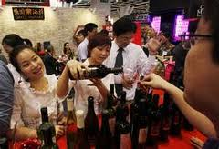
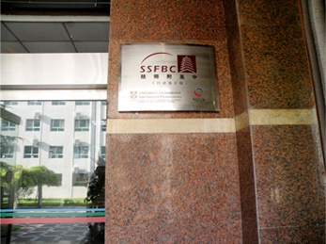
Who is affected by the following businesses?

Slide 4
Shareholders/Owners - who want short-term profit and long-term growth, helped by a positive image
Staff - who want, wages, job security and good prospects
Customers - want good products and low prices
Creditors - want profit, growth, paid on time
Local People/Community-want jobs, trade and no pollution
Government - wants taxes, growth, exports and status
Note-a person can belong to several stakeholder groups

Slide 5
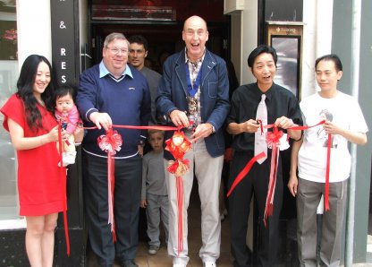
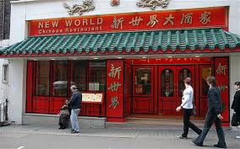
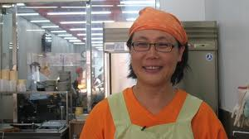
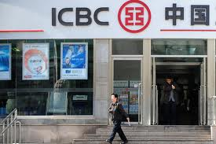
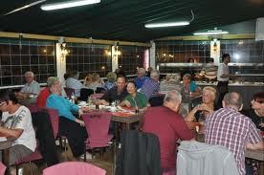
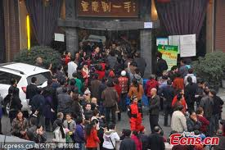
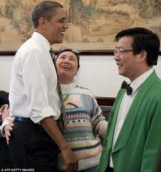

Slide 6
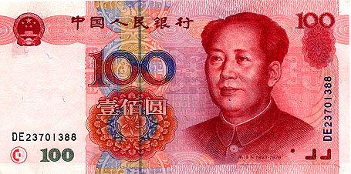
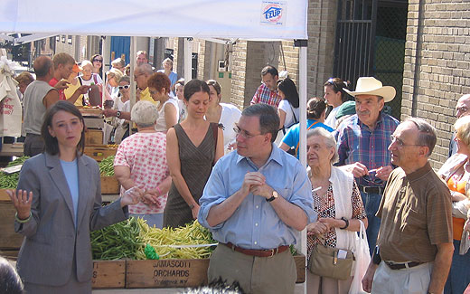
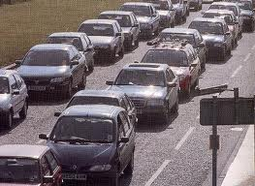
Business Decision-Build New Building

Slide 7
Responsibilities to Customers
To meet customers’ needs and wants at affordable prices
Not to mislead/Lie
Not to pressurise vulnerable people
Consumer loyalty
Repeat purchases
Good publicity, including “word-of-mouth” recommendations
Good customer feedback which helps improve further goods and services

Slide 8
Responsibilities to Suppliers
Supplier loyalty- supplier will meet deadlines and meet requests for ‘special orders’. May offer more reasonable credit terms as well
Good sources of supplies of components and raw materials must be found ,as these will influence the quality of your end product
In return a firm should, pay promptly, place regular orders and offer long-term contracts

Slide 9
Responsibilities to Employees
Meet legal obligations and responsibilities including:
training,
job security,
paying more than the minimum wage (if very low),
offering good working conditions and
involving staff in decision-making
Employer loyalty and low ‘labour/staff turnover’
Staff who leave in year x100 Number of staff
Activity 5.3 on page 76

Slide 10
Responsibilities to Local Community
Offer secure jobs-to reduce fear and uncertainties
Provide community support and sponsor projects to get favourable decisions from local officials as local councils only award contracts to firms with a history of community involvement
Positive responses from local government administration
Local communities might accept some negative effects from a community supportive firm

Slide 11
Responsibilities to Government
Meet ALL legal obligations:
pay taxes on time
complete surveys as and when requested
Government contracts may be forthcoming
Possible subsidies and grants
Licences (to expand) are more likely to be granted for a business that meets all its wider responsibilities to society

Slide 12
Corporate Social Responsibility (CSR)
CSR policy functions as a built-in, self-regulating mechanism whereby a business monitors and ensures its active compliance with the spirit of the law and ethical standards
The goal of CSR is to embrace responsibility for the company's actions and encourage a positive impact through its activities on the environment, consumers, employees, communities and all other stakeholders

Slide 13
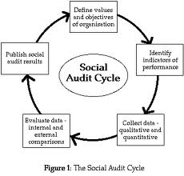
Social Audits/SA’s (independent annual check of a firm’s CSR)

Slide 14
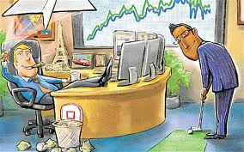
Can Businesses satisfy ALL stakeholder groups?
Traditional ‘Shareholder Approach’ sees duties being met to others as reducing profits
Modern, inclusive ‘Stakeholder Approach’ sees LR gains that also benefit shareholders
We also have seen occasions where one group loses out to the benefit of others-many business decisions are like this
COMPROMISE is often the answer with management basing decisions on PRIORITIES-shareholders will always figure highly here
Getting these decisions right is one of the justifications of why management are often paid such high salaries
Task 5.5 on page 80

